Slide 1
OBJECT DETECTION AND IDENTIFICATION FOR DEAF AND BLIND PEOPLE IN A VIDEO SCENE
PROJECT GUIDE: DR. JOSEPHINE LEELA ,M.E,Ph.D
TEAM MEMBERS:
D RUPASREE [ROLLNO:2018PECCS122]
LEBASINI RR[ROLLNO: 2018PECCS158]
D HARIKA RAMAKRISHNA[ROLL NO: 2018PECCS124]
BATCH : A10
Project Domain : EMBEDDED & IOT

Slide 2
INTRODUCTION
This project investigates methods and procedures to construct an efficient system to assist blinds in their everyday life.
In particular, various technologies that can be utilized to build a wearable system are examined.
The machine vision and the communication component of the blind navigation and guidance is designed not only to search the surroundings environment but also to determine safety.
This work highlights the importance and also provides the instructions to blinds for efficient navigation and safe guidance by incorporating object/pedestrian detection in real-time.

Slide 3
LITERATURE SURVEY
AUTHOR | METHODLOGY | MAJOR FINDINGS
Shubham Melvin Felix, Sumer Kumar, and A. Veeramuthu | Impaired, AI, Machine Learning, Voice Assistant, Chat bot, Image Recognition. . | Smart portable assistant system for blind
Giancarlo Iannizzotto, Lucia Lo Bello Andrea, Nucita, Giorgio Mario Grasso | Smart home, virtual assistant, computer vision, deep learning. I | Interactive smart home
Prince Bose, Apurva Malpthak, Utkarsh Bansal, Ashish Harsola | Voice assistant, Speech Recognition, Low cost, Internet, Speech Synthesis, Blind, Visually Challenged, Raspberry Pi | Navigation for the visually challenged using voice instructions and haptic feedbacks can be added to improve the existing system.

Slide 4
LITERATURE SURVEY
AUTHOR | METHODLOGY | MAJOR FINDINGS
Kumar Yelamarthi | depth sensor; haptic feedback; blind; navigation assistance | Assistant system for blind people in rough terrain
Md. Siddiqur Rahman Tanveer, M.M.A. Hashem and Md. Kowsar Hossain | Arduino;Android; RFID; Ultrasonic; GSM; GPS; Server; JSON; Microcontroller; Pulse; Analog; Modulation; | Smart portable assistant system for blind

Slide 5
PROBLEM DEFINITION
Blindness is a state of lacking the visual perception due to neurological or physiological factors.
The partial blindness represents the lack of integration in the growth of the optic visual or nerve center of the eye, and total blindness is the full absence of the visual light perception.
In this work, cheap, a simple friendly user, smart blind guidance system is designed and implemented to improve the mobility of both blind and visually impaired people in a specific area.
The proposed work includes a wearable equipment consists of light weight blind stick and sensor based obstacle detection circuit is developed to help the blind person to navigate alone safely and to avoid any obstacles that may be encountered, whether fixed or mobile, to prevent any possible accident.
The main objective of this project is to develop an application for blind people to detect the objects in various directions, detecting pits and manholes on the ground to make free to walk Detecting objects using image processing can be used in multiple industrial as well as social applications

Slide 6
DEVELOPMENT ENVIRONMENT
HARDWARE ENVIRONMENT
Raspberry pi kit
Camera
Haptic strip
SOFTWARE ENVIRONMENT
Raspberry pi OS: Raspbian stretch
Programming platform: python 3 IDLE
Programing language: python 3
Library: OpenCV

Slide 7
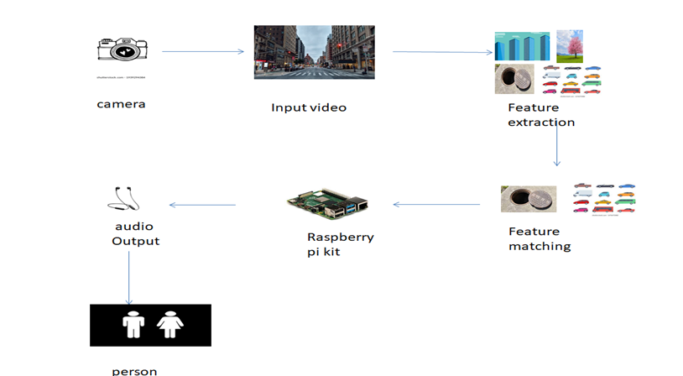
SYSTEM ARCHITECTURE

Slide 8
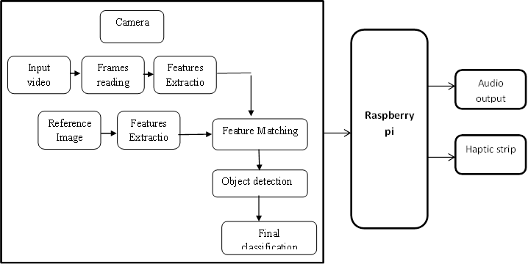
SYSTEM DESIGN BLOCK DIAGRAM

Slide 9
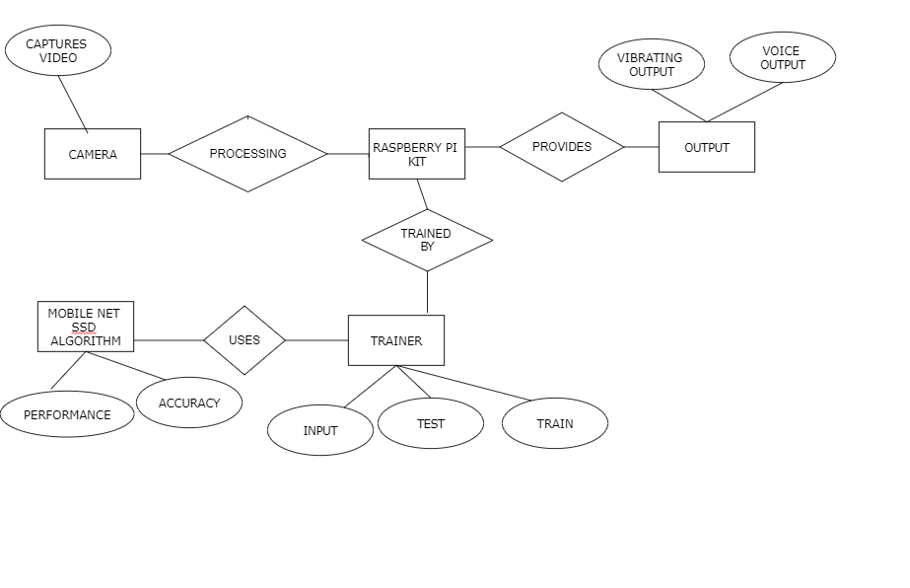
ER DIAGRAM

Slide 10
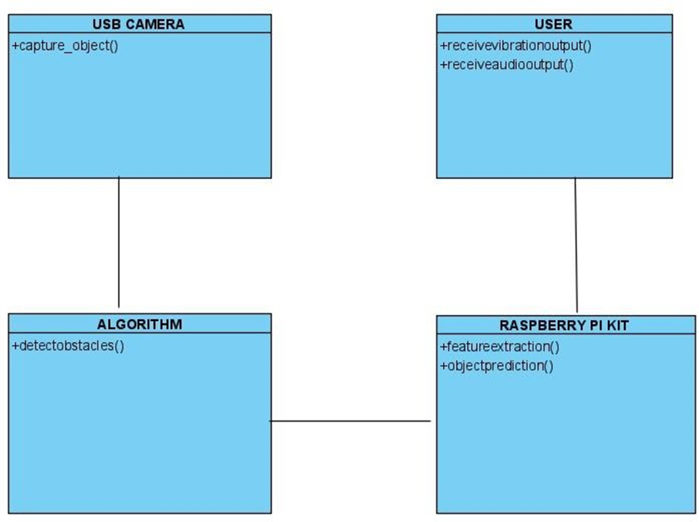
CLASS DIAGRAM

Slide 11
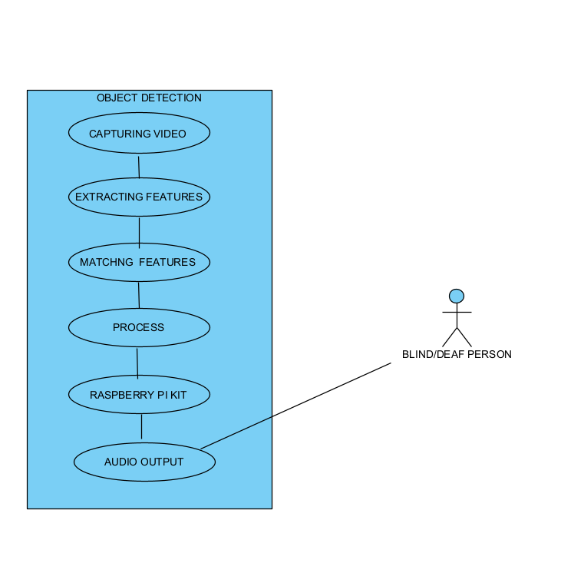
USE CASE DIAGRAM

Slide 12
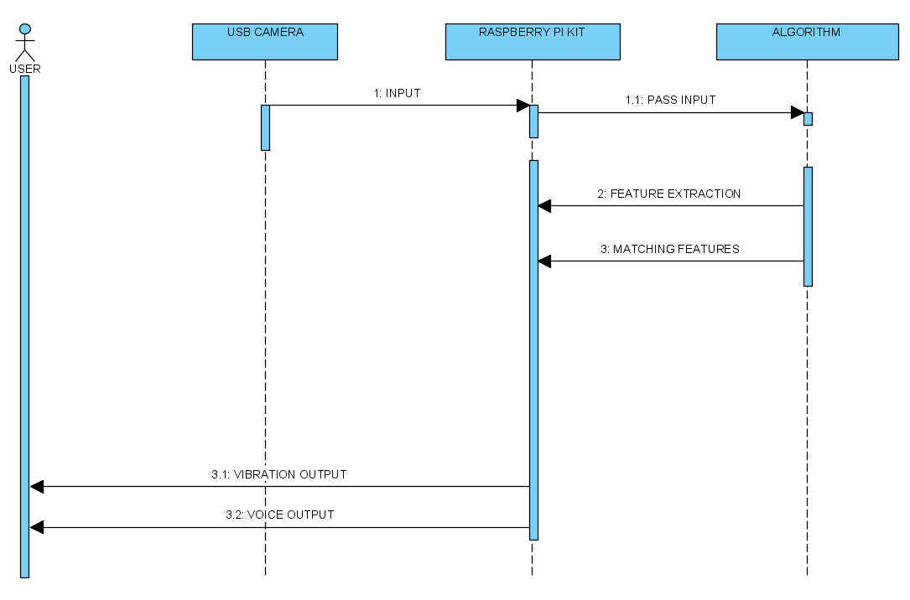
SEQUENCE DIAGRAM

Slide 13
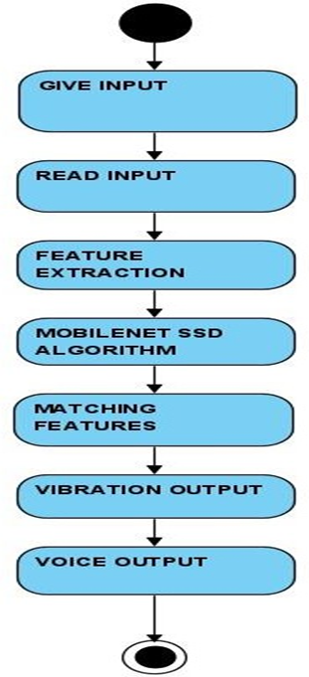
ACTIVITY DIAGRAM

Slide 14
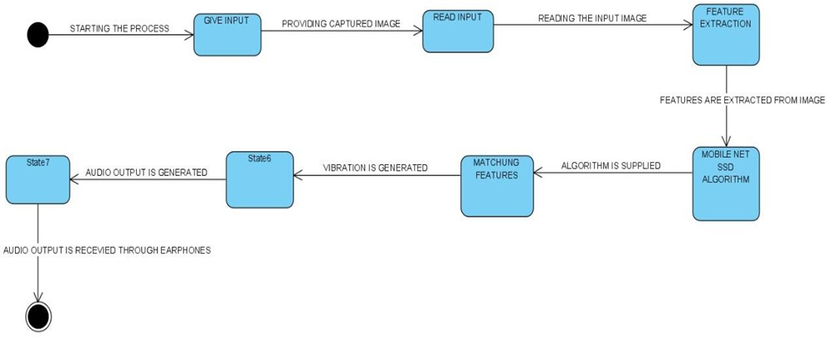
STATE CHART DIAGRAM

Slide 15
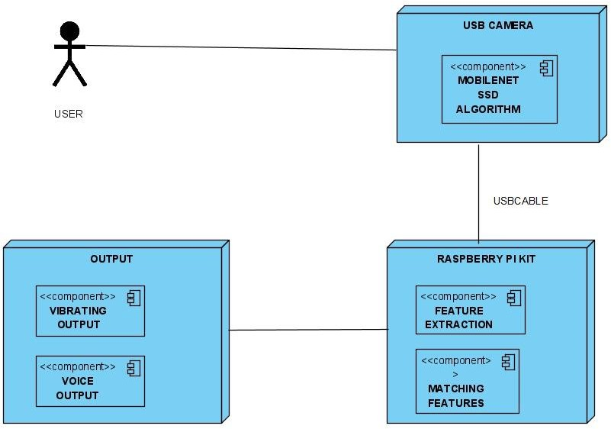
DEPLOYMENT DIAGRAM

Slide 16
MODULE DESCRIPTION
Video acquisition
Feature extraction
Object detection
Training
Testing

Slide 17
VIDEO ACQUISITION
IP web cam application is installed in the android mobile.
Once the server is installed and then copy the ip address and paste it in the code and then save it.
Once the code is executed , then through the application the video is captured and the process takes place.

Slide 18
FEATURE EXTRACTION
The main purpose of using features instead of raw pixel values as the input to a learning algorithm is to reduce/increase the in-class/out of class variability compared to the raw input data, and thus making classification easier.
Open CV systems generally exploit a single camera to capture image data.
Recognition is then performed based on various features extracted from that data.
In addition, features extraction is the process by which certain features of interest within an image are detected and represented for further processing.
It is a critical step in most computer vision and image processing solutions because it marks the transition from pictorial to non-pictorial (alphanumerical, usually quantitative) data representation .

Slide 19
OBECT DETECTION
Object detection is a computer technology related to computer vision and image processing that deals with detecting instances of semantic objects of a certain class (such as humans, buildings, or cars) in digital images and videos.
Well-researched domains of object detection include face detection and pedestrian detection.
Object detection has applications in many areas of computer vision, including image retrieval and video surveillance.

Slide 20
TRAINING
The objects of video captured is collected.
The collected image is preprocessed and features like distance, object type are extracted.
Based on the features extracted the model is trained.

Slide 21
TESTING
The object from the camera is collected.
The collected image is preprocessed and required features like distance, object type is extracted from the image.
Based on the trained data, the system tests the feature extracted and predicts the object distance.

Slide 22
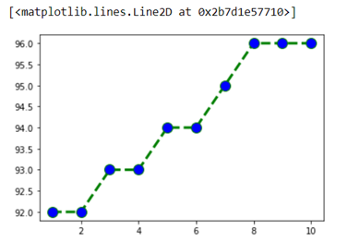
PERFORMANCE ANALYSIS TELEVISION
Accuracy
Time Frame
We have plot a graph of Performance Metrics w.r.t Accuracy . It can be seen as follows:
X-Axis: Time Frame(in Sec.)
Y-AXIS:Accuracy Metrics(in percentage)

Slide 23
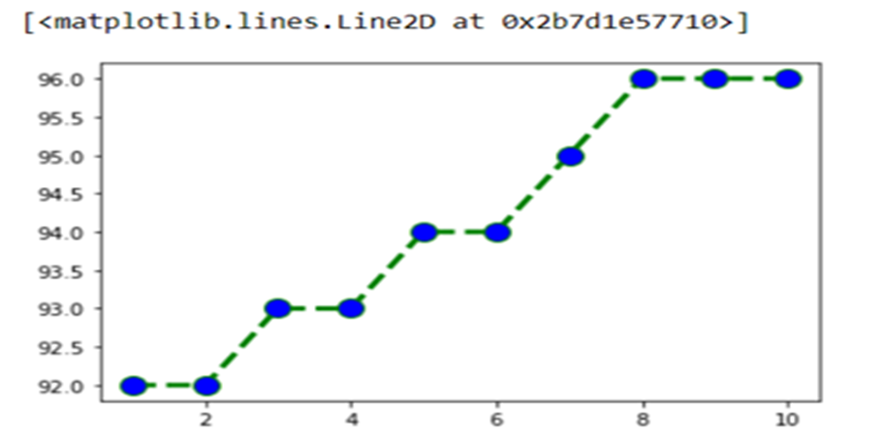
CHAIR
Accuracy
Time Frame
We have plot a graph of Performance Metrics w.r.t Accuracy . It can be seen as follows:
X-Axis: Time Frame(in Sec.)
Y-AXIS:Accuracy Metrics(in percentage)

Slide 24
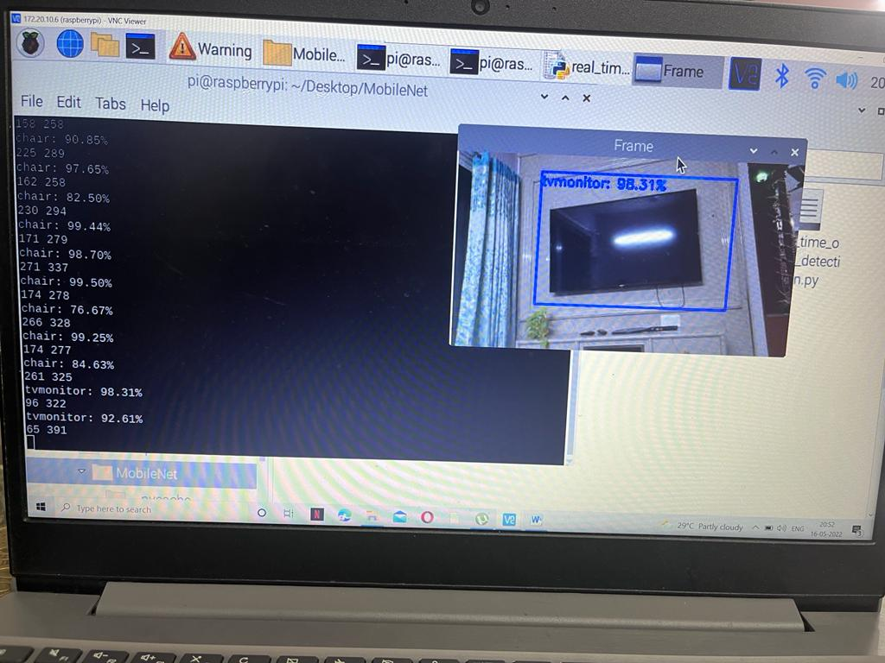
SCREENSHOTS
TV is detected with an accuracy of 98.31%

Slide 25
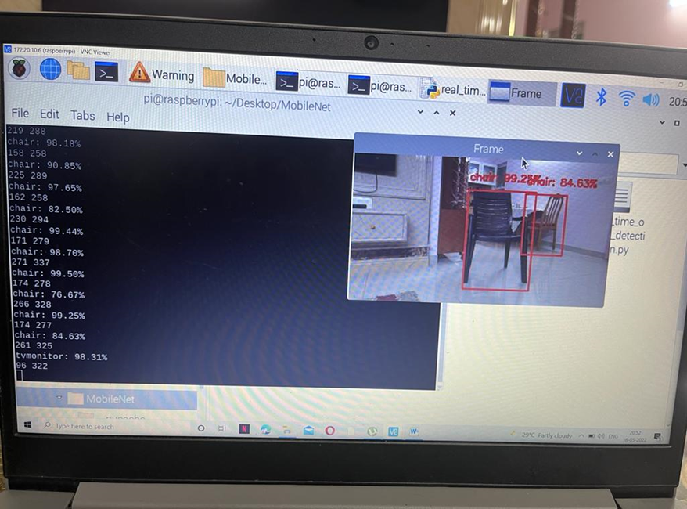
Chair is detected with an accuracy of 99.25%

Slide 26
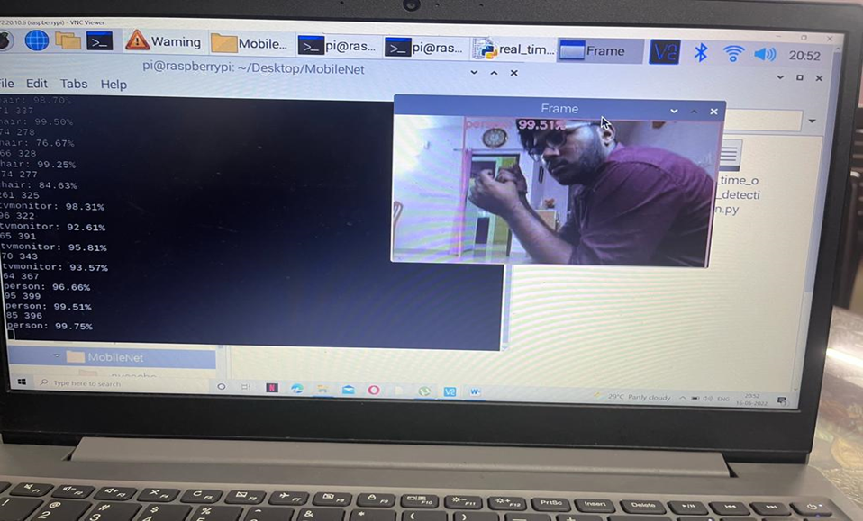
A person is detected with an accuracy of 99.51%

Slide 27
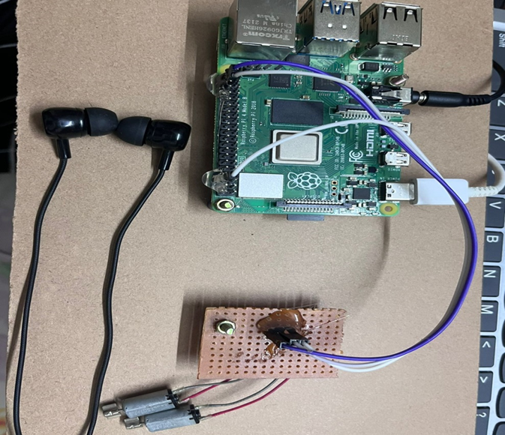
AUDIO OUTPUT

Slide 28
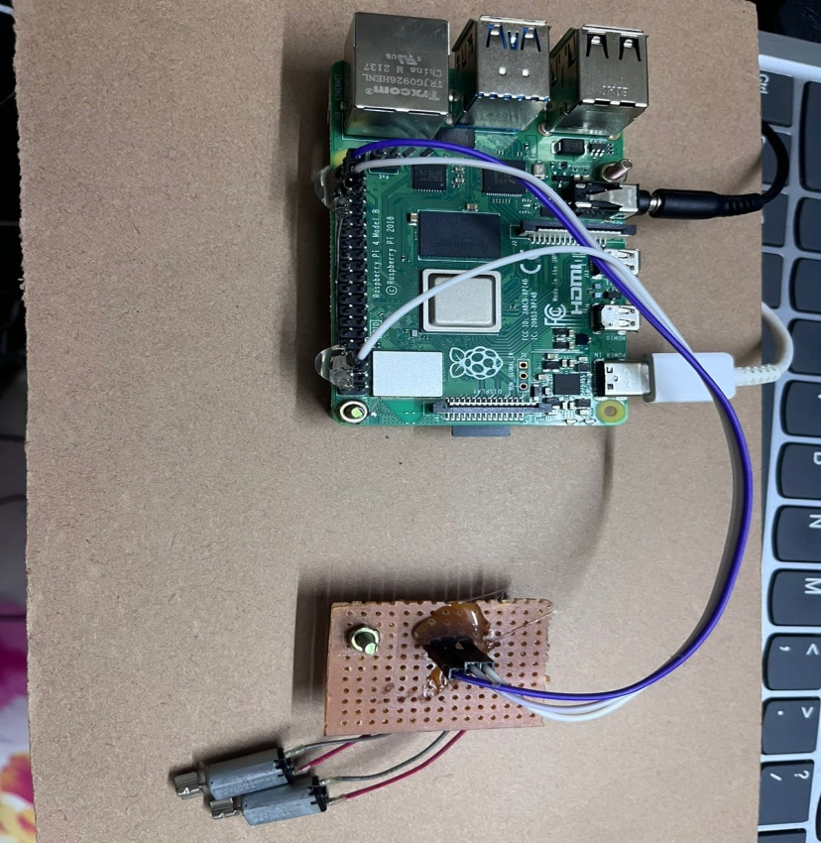
VIBRATION OUTPUT

Slide 29
CONCLUSION
This project provides a means of active interaction and navigation between the system and the blind person.
Our aim is to make the affected person free of human help and this proves to be useful for them and implementable in a real time.

Slide 30
REFERENCES
[1] Shubham Melvin Felix, Sumer Kumar, and A. Veeramuthu, A Smart Personal AI Assistant for Visually Impaired People,2018.
[2] Giancarlo Iannizzotto,Lucia Lo BelloAndrea,Nucita,Giorgio Mario Grasso, A vision and speech enabled, customizable, virtual assistant for smart environments,2018.
[3] Prince Bose, Apurva Malpthak, Utkarsh Bansal, Ashish Harsola, Digital Assistant For The Blind,2017.
[4] Md. Siddiqur Rahman Tanveer, M.M.A. Hashem and Md. Kowsar Hossain, Android Assistant EyeMate for Blind and Blind Tracker ,2015.
[5] Kumar Yelamarthi, Navigation Assistive System for the Blind using a Portable Depth Sensor,2015.

Slide 31
[6] D. and J. H. Martin, “Logistic Regression,” in Speech and Language Processing, 2015
[7]J. Huang, V. Rathod, C. Sun, M. Zhu, A. Korattikara, A. Fathi, I. Fischer, Z. Wojna, Y. Song, S. Guadarrama, and K. Murphy, “Speed/Accuracy Trade-Offs for Modern Convolutional Object Detectors,” 2017 IEEE Conference on Computer Vision and Pattern Recognition (CVPR), 2017.
[8]P.Y.Kumbhar,M.Attaullah,S.Dhere,andS.Hipparagi,“RealTime Face Detection and Tracking Using OpenCV,” International Journal for Research in Emerging Science And Technology, vol. 4, no. 4, pp. 39–43, Apr. 2014.
[9]B.-S. Lin, C.-C. Lee, and P.-Y. Chiang, “Simple Smartphone-Based Guiding System for Visually Impaired People,” Sensors, vol. 17, no. 6, p. 1371, 2013

